Slide 1
Adaptive Auto-Scaling of Microservices Using Predictive Workload Mid-Sem Viva Presentation
Harsh Pandey
Mtech Software Systems
2024mt12036@wilp.bits-pilani.ac.in

Slide 2
Introduction
Rapid adoption of microservices architecture in cloud-native systems
Dynamic workloads cause performance instability
Auto-scaling is essential for:
Maintaining performance
Efficient resource utilization

Slide 3
Problem with Existing Systems:
Most systems use reactive scaling
Scaling happens after overload
Leads to:
Latency spikes
SLA violations
Delayed response

Slide 4
Problem Statement
Reactive scaling is delay-prone and inefficient
Cannot handle sudden workload spikes effectively
Results in:
Poor user experience
Resource inefficiency

Slide 5
Objectives
Design a microservices-based scalable system
Implement real-time workload monitoring
Develop a prediction model
Implement forecast-based scaling controller
Compare reactive vs predictive scaling

Slide 6
Literature Review
Existing Approaches:
Threshold-based scaling
Simple but reactive
Delayed response
Rule-based scaling
Static rules
Limited adaptability
Machine Learning-based scaling
Uses forecasting models
Improves decision-making
Research Gap:
Most systems:
Focus only on reactive methods
Lack lightweight predictive models
Limited real-time implementation

Slide 7
Research Methodology
Approach:
Microservices implementation
Workload monitoring
Data collection
Prediction modeling
Scaling decision logic
Performance evaluation

Slide 8
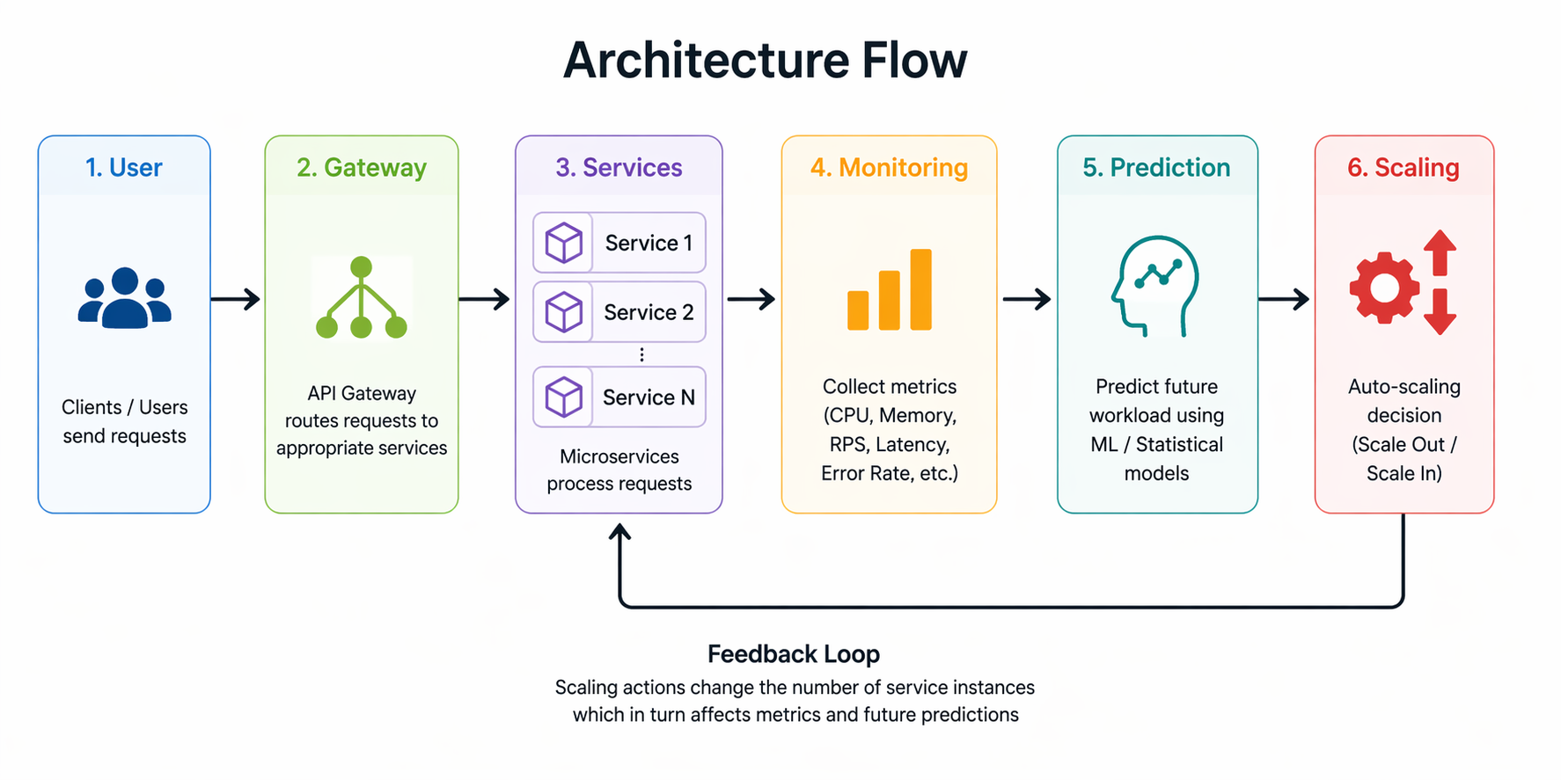
System Architecture

Slide 9
System Architecture
API Gateway handles requests
Microservices process workload
Monitoring collects metrics
Prediction engine forecasts demand
Scaling controller adjusts replicas

Slide 10
Data Collection
What Data You Collect:
Request rate (RPS)
Latency
Error rate
Replica count
How:
Continuous monitoring module
Stored in database
Used for prediction
Data Characteristics:
Time-series data
Dynamic and bursty
Real-time updates

Slide 11
Prediction Model
Model Used:
Moving Average
Linear Regression
Formula:
👉 L̂(t+1) = αLt + (1 − α)L̂t
Evaluation Metrics:
MAE (Mean Absolute Error)
RMSE (Root Mean Square Error)

Slide 12
Scaling Strategy
Key Results:
Reduced latency spikes
Improved scaling response time
Better resource utilization

Slide 13
Experimental Setup
Simulated workload scenarios:
Burst load
Gradual load
Comparison:
Reactive vs Predictive
Metrics analyzed:
Latency
SLA violations
Resource utilization

Slide 14
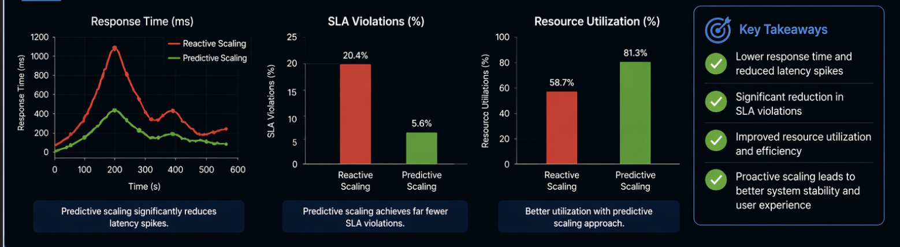
Results & Analysis
Key Results:
Reduced latency spikes
Improved scaling response time
Better resource utilization

Slide 15
Current Progress
Architecture design ✅
Microservices implemented ✅
Monitoring module ⚙️
Prediction model ⚙️
Scaling logic ⚙️

Slide 16
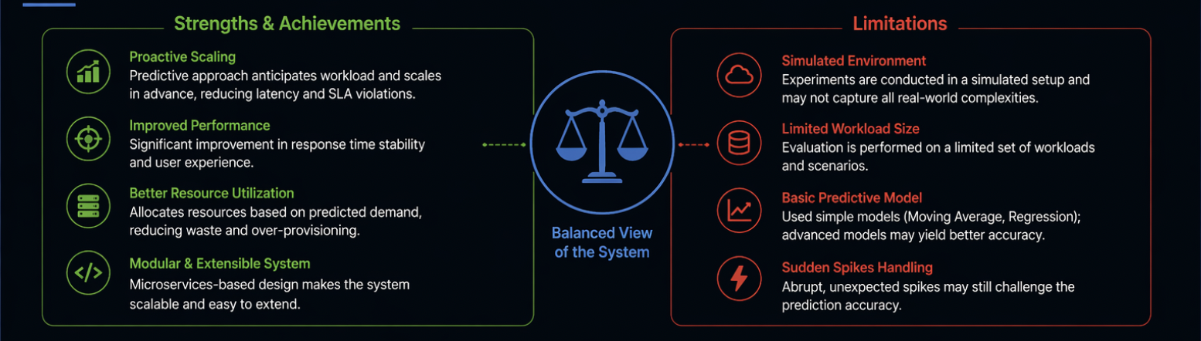
Conclusion
Predictive scaling improves system performance
Reduces latency and SLA violations
Demonstrates integration of ML + distributed systems

Slide 17
Q & A

Slide 18
Thank You

